Slide 1
SIC Week 3

Slide 2
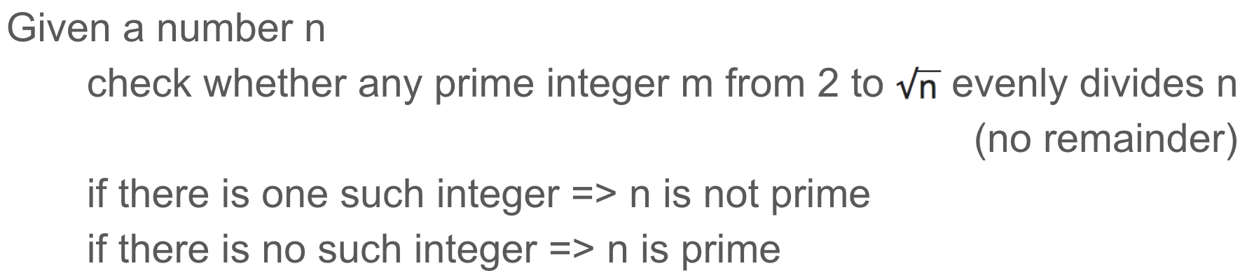
Question 1a
Which of the following numbers is not a prime number
313,317,379,887,983, 992, 997
The simplest primality test: trial division
Answer: 992 is not a prime number, the other numbers are prime

Slide 3
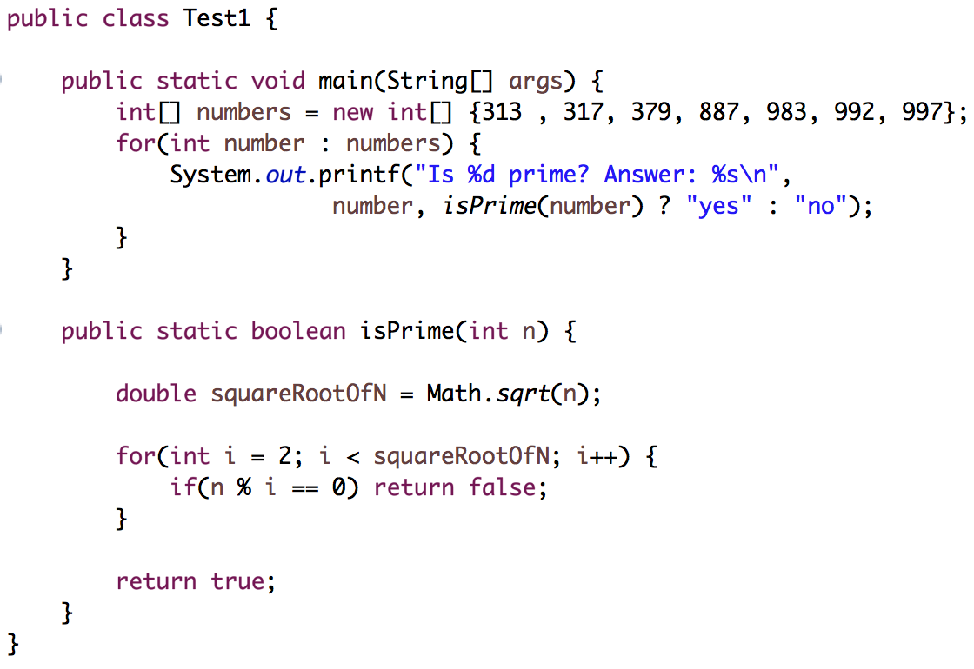
Question 1a (Java Code)
Output:
Is 313 prime? Answer: yes
Is 317 prime? Answer: yes
Is 379 prime? Answer: yes
Is 887 prime? Answer: yes
Is 983 prime? Answer: yes
Is 992 prime? Answer: no
Is 997 prime? Answer: yes

Slide 4
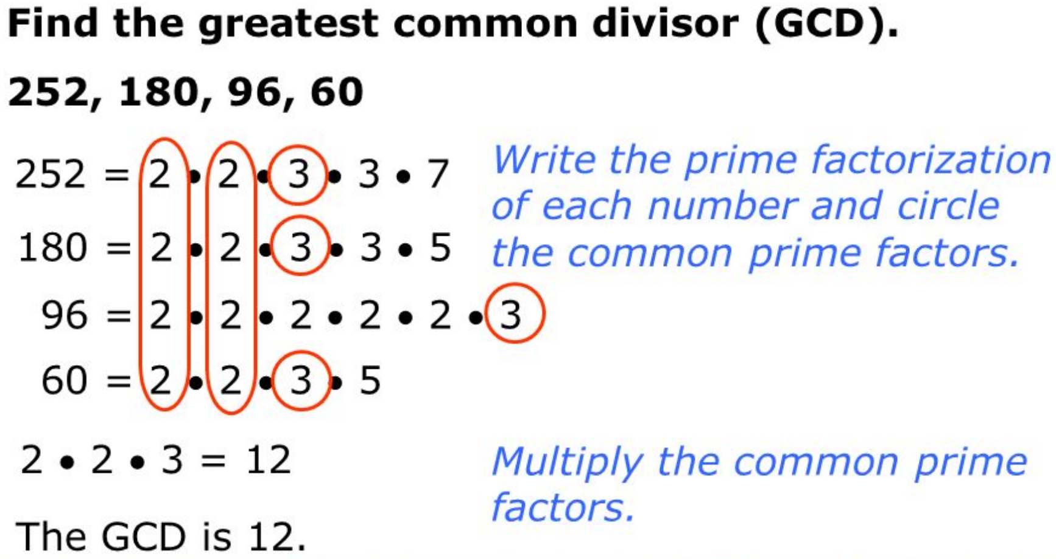
Question 1 b, c, d
How to find greatest common divisor:
GCD(8, 12) = 4
GCD(9, 21) = 3
GCD(9, 11) = 1

Slide 5
Question 1 e,
What is the value of 51 mod 5
i.e. what is the remainder of 51 / 5?
answer: 51 = 10 * 5 + 1 => 51 mod 5 = 1
What is the value of 389 mod 77
answer: 4

Slide 6
Question 1 f, g
Find two coprime numbers
The probability that any two integers taken randomly are coprime is nearly 60%
(http://mathworld.wolfram.com/RelativelyPrime.html)
Pick 2 random number and check gcd(a, b)
if gcd(a, b) = 1
a and b are coprime
else
a, b are not coprime
Example: integers coprime to 12: 5,7,11,13,17,19,23,25
because gcd(12, 5) = 1, gcd(12, 7) = 1, gcd(12, 19) = 1 ......
Are 6 and 30 coprime?
No, because gcd(6, 30) is 6, not 1

Slide 7
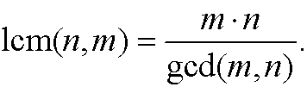
Question 1 h
Find out LCM(30,60) and LCM(14, 21)
LCM(30, 60) = 30 * 60 / gcd(30, 60) = 1800 / 30 = 60
LCM(14, 21) = 14 * 21 / gcd(14, 21) = 14 * 21 / 7 = 42

Slide 8
Question 2 (Modular arithmetic)
Online calculator:
http://www.wolframalpha.com
https://www.mtholyoke.edu/courses/quenell/s2003/ma139/js/powermod.html
https://planetcalc.com/3311/
10¹⁹ mod 33 = 10
5¹¹ mod 77 = 38
7⁻¹ mod 33 = multiplicative inverse of 7 mod 33 = 19
because 19 * 7 = 1 mod 33
23⁻¹ mod 551 = multiplicative inverse of 23 mod 551 = 24
because 24 * 23 = 1 mod 551

Slide 9
Question 2: RSA
Choose a prime number e
e is coprime to 𝞥(n),
i.e. 𝞥(n) is not divisible by e
gcd(e, 504) = 1
Let select e in 1 < e < 𝞥(n)
=> Let's pick e = 59
Public key (n, e) = (551, 59)
Private key generation
Let d be the private key
=> de = 1 mod 𝞥(n)
=> d * 59 = 1 mod 504
=> d = 299
Key generation (receiver Bob)
Pick two prime numbers
p = 19 and q = 29
Calculate n
n = p * q = 19 * 29 = 551
Calculate 𝞥(n)
𝞥(n) = (p - 1) * (q - 1)
= (19 - 1) * (29 - 1) = 504

Slide 10
Question 2: RSA
Encryption (sender Alice)
Receive Bob's public key
(n, e) = (551, 59)
Use the public key to encrypt a message M = 100
C = Me mod n
= 100⁵⁹ mod 551 = 370
Send the ciphertext C = 370 to Bob
Decryption (receiver Bob)
Bob receives ciphertext C = 370 from Alice
Bob use the private key d = 299 to decrypt
M = C^{d} mod n
= 370²⁹⁹ mod 551
= 100

Slide 11
Question 3: RSA
Choose a prime number e
e is coprime to 𝞥(n),
i.e. 𝞥(n) is not divisible by e
gcd(e, 20) = 1
Let select e in 1 < e < 𝞥(n)
=> Let's pick e = 7
Public key (n, e) = (33, 7)
Private key generation
Let d be the private key
=> de = 1 mod 𝞥(n)
=> d * 7 = 1 mod 20
=> d = 3
Key generation (receiver Bob)
Pick two prime numbers
p = 3 and q = 11
Calculate n
n = p * q = 3 * 11 = 33
Calculate 𝞥(n)
𝞥(n) = (p - 1) * (q - 1)
= (3 - 1) * (11 - 1) = 20

Slide 12
Question 3: RSA (continue)
Encryption (sender Alice)
Receive Bob's public key
(n, e) = (33, 7)
Use the public key to encrypt a message M = 2
C = Me mod n
= 2⁷ mod 33 = 29
Send the ciphertext C = 29 to Bob
Decryption (receiver Bob)
Bob receives ciphertext C = 29 from Alice
Bob use the private key d = 3 to decrypt
M = C^{d} mod n
= 29³ mod 33
= 2

Slide 13
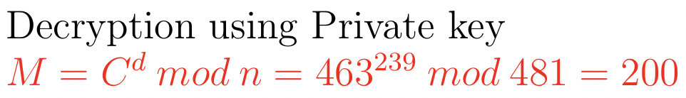

Question 4
Trudy factorizes 481
481 = 13 * 37
Given C = 463
Given e = 47
If d is the private key, then
Verify that encryption using the public key generates the intended value:
d * 47 = 1 mod 432
=> d is the multiplicative inverse of 47 mod 432
=> d = 239 by using Wolfram Alpha website

Slide 14
Link to slides
https://tinyurl.com/y8p67m87
Notes in Week 4:
https://docs.google.com/document/d/1roabI1BR4UKHEUYxNb7BrvOC0ytxNcv4MG8AbwdZt2g/edit?usp=sharing
Asymmetric Key Operations with RSA and OpenSSL
https://docs.google.com/document/d/13XrFhfhohokiP_68Nxa7-7jU480IguQCe_OeQH52ViY/edit?usp=sharing

